Slide 1
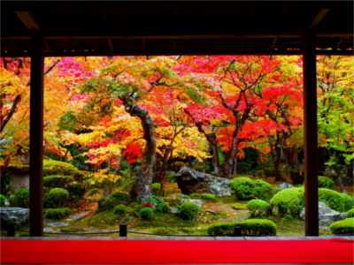
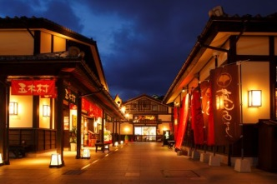
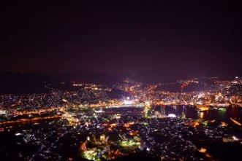
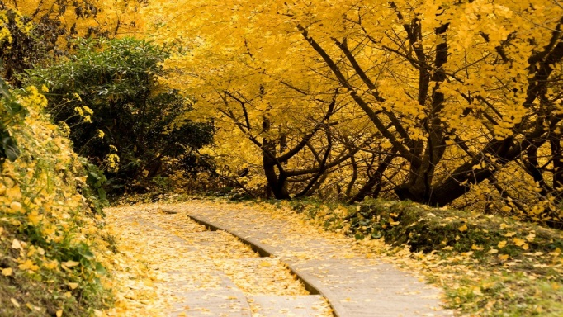
2019 KYUSHU
AUTUMN TOUR
～I’m in love with it!!～
CHECK OUT
THE PHOTO!
DAY1 L/D
NOV 26 FUKUOKA-NAGASAKI
Dazaifu Tenmangu Shrine
Mifuneyama Rakuen
Inasayama Night View
DAY2 B/L/D
NOV 27 NAGASAKI-KUMAMOTO
Unzen Hells + Egg
Ferry Ride
Suizenji Garden
Kumamoto Castle
Josaien
DAY3 B/L/D
NOV 28 KUMAMOTO-KAGOSHIMA
Black Vinegar Factory
Tarumizu Ichoen
Arimura Lava Observatory
-Foot Bath

Slide 2
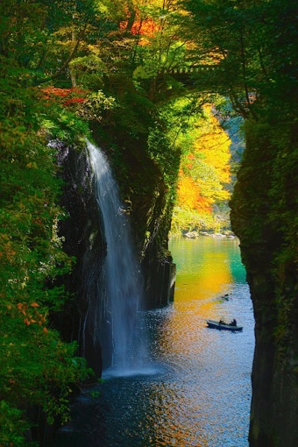
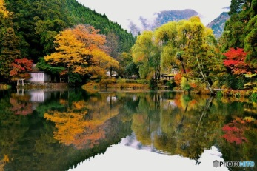
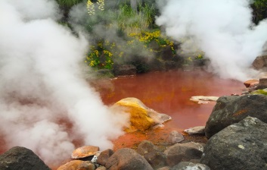
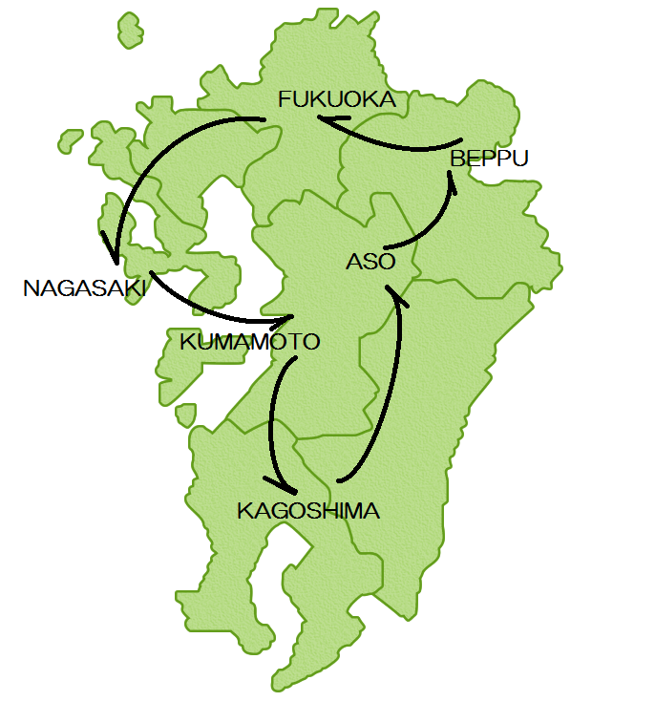
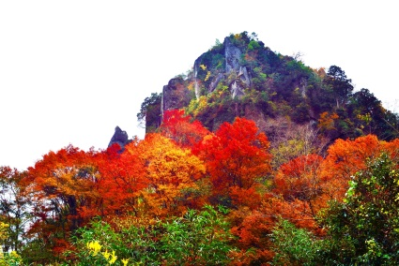
DAY4 B/L/D
NOV 29 KAGOSHIMA-ASO
Takachiho Gorge
Manai Waterfall
Aso Daikanbo
DAY5 B/L/D
NOV 30 KUJU-BEPPU
Kokonoe Suspension Bridge
Yufuin Yunotsubokaido
Kinrin Lake
Yufuin no Mori Train
Japanese Lunch Box
African Safari
DAY6 B/L
DEC 1 BEPPU-FUKUOKA
Beppu Hells (Sea, Blood Pond)
lunch-reference:steamed cuisine
Yabakei
Beer Factory Observation
DAY7 B
DEC 2 FLY BACK HOME
WHAT’S KYUSHU?
Kyushu is a big island that has a volcanic mountains
at the center of the island. Our Tour is going around
the Northern part of Kyushu.
While Tokyo/Osaka is catching lots of tourists attention,
Kyushu has the unique culture and natures that will be
worth for you to visit. Good Nature creates good food and
Kind peoples. Come join our tour, you will get tons of
unforgettable memories!
CONTACT
Asia Net Tour
Address: 1-831-1 Matsuda, Higashi-ku, Fukuoka City, Fukuoka, JAPAN
TEL+81-92-409-5598 / FAX+81-92-409-5599
Manager-Momoe(Japanese/Chinese Speaker) momoe@asianettour.co.jp
Operator-Lisa(Japanese/English Speaker) tkt@asianettour.co.jp
HP: https://asianettour.com/

