Slide 1
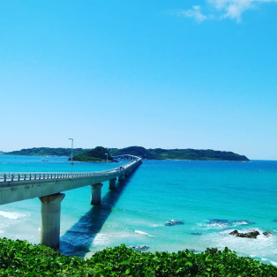
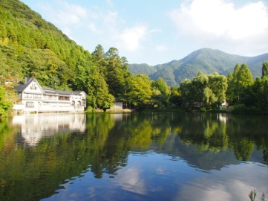
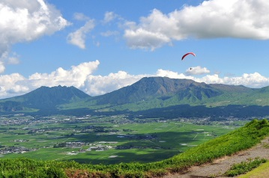
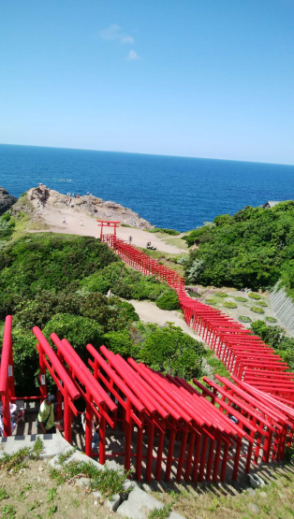
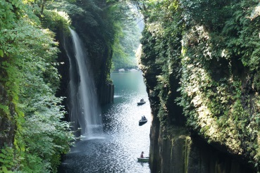
2019 KYUSHU
SUMMER TOUR
～I’m in love with it!!～
DAY1 L/D
AUG 21 FUKUOKA-SHIMONOSEKI
Kanmon Bridge
Lunch-puffer fish
Tsunoshima Ohashi
Motonosumi Shrine
DAY2 B/D
AUG 22 BEPPU-ASO
Beppu Umi Hell
Yufuin Yunotsubo Kaido
Kinrin Lake
Kokonoe Suspension Bridge
Aso Daikanbo
DAY3 B/L/D
AUG 23 TAKACHIHO-KIRISHIMA
Takachiho Gorge
Manai Waterfall
Kirishima Shrine
Check out
The PHOTO!

Slide 2
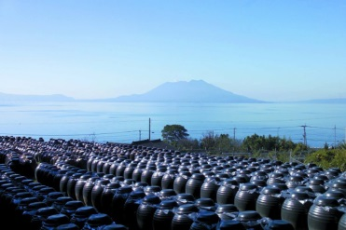
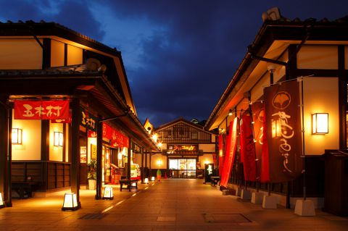
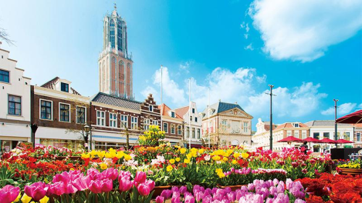
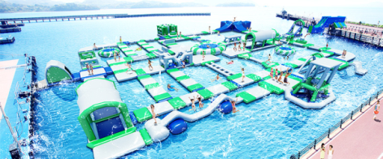
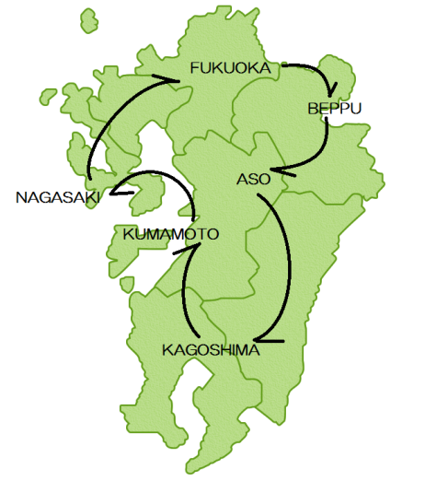
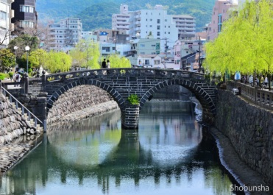
DAY4 B/L/D
AUG 24 KIRISHIMA-KUMAMOTO
Black Vinegar Factory
Kumamoto Shimotori
Kumamoto Castle
Kumamoto Josaien
Hikawa Fireworks – from bus
DAY5 B/D
AUG 25 SASEBO-NAGASAKI
Ferry Ride
HUIS TEN BOSH
Inasayama Night View
DAY6 B/D
AUG 26 TOSU-FUKUOKA
Spectacles bridge
Tosu Premium Oulet
Tosu Premium Outlet
Beer Factory Observation
Canal City Hakata
DAY7 B
AUG 27 FLY BACK HOME
WHAT’S KYUSHU?
Kyushu is a big island that has a volcanic mountains
at the center of the island. Our Tour is going around
the Northern part of Kyushu.
While Tokyo/Osaka is catching lots of tourists attention,
Kyushu has the unique culture and natures that will be
worth for you to visit. Good Nature creates good food and
Kind peoples. Come join our tour, you will get tons of
unforgettable memories!
CONTACT
Asia Net Tour
Address: 1-831-1 Matsuda, Higashi-ku, Fukuoka City, Fukuoka, JAPAN
TEL+81-92-409-5598 / FAX+81-92-409-5599
Manager-Momoe(Japanese/Chinese Speaker) momoe@asianettour.co.jp
Operator-Lisa(Japanese/English Speaker) tkt@asianettour.co.jp
HP: https://asianettour.com/

